Slide 1
What is Selection Sort?
Selection sort selects the smallest element from an unsorted list in each iteration and places that element at the beginning of the unsorted list.

Slide 2
Selection Sort
2
3
4
5
1

Slide 3
Selection Sort
2
3
4
5
1

Slide 4
Selection Sort
1
3
4
5
2

Slide 5
Selection Sort
1
2
4
5
3

Slide 6
Selection Sort
1
2
3
5
4

Slide 7
Selection Sort
1
2
3
4
5

Slide 8
Selection Sort
1
2
3
4
5
Sorting Finished!

Slide 9
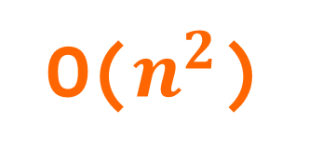
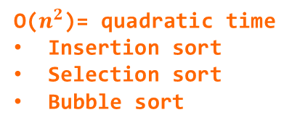
O($n^{2}$)
O(n log n)
O($n^{2}$)= quadratic time
Insertion sort
Selection sort
Bubble sort
O(n)
time
O(log n)
data

